Slide 1

Vision Zero Initiative
Analyzing Traffic Accidents in NYC
Abdullah Ar Rafee
Advanced Policy Analysis
Syracuse University
Spring 2022

Slide 2
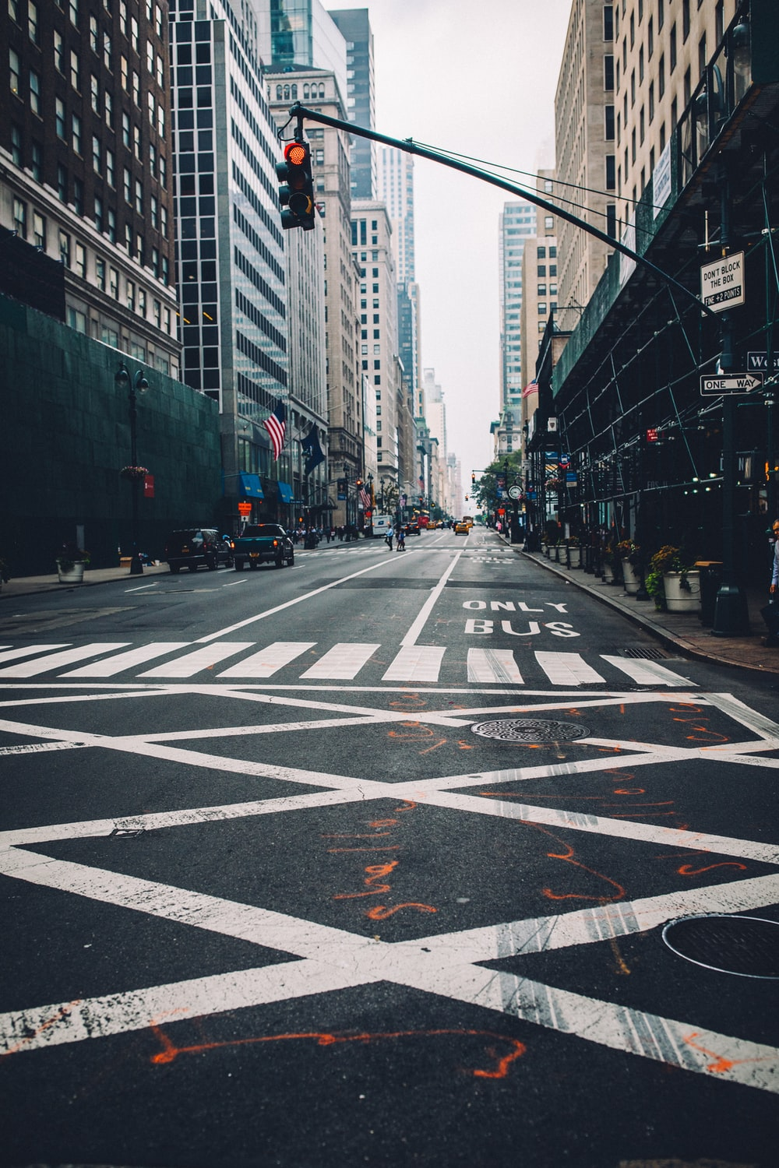
Problem Scenario/ Research Significance:
NYC Mayor implemented the Zero Vision Initiative in 2014 to reduce traffic accidents
Involves a host of legislative, technological, educational, and other enforcement related transformation
Claims that it has been widely successful
Post pandemic traffic accidents have been on the rise
Are the claims true?

Slide 3
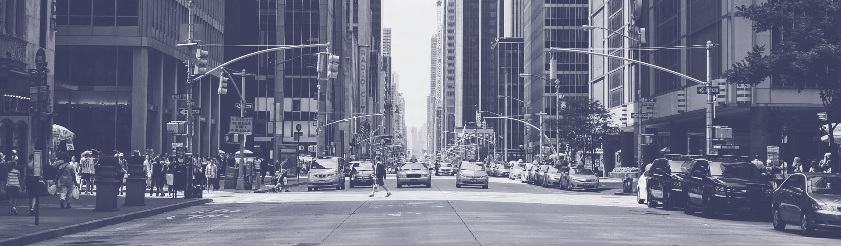
Questions:
How has traffic accidents since the enactment of the policy?
What are the key drivers?
Which boroughs have the highest accidents?
How do fatalities compare to injuries?

Slide 4

Data Sources
NYC Open Data
Motor Vehicle Collisions – Crashes (2012 – 2022)
Traffic Violations (2018-2022)

Slide 5
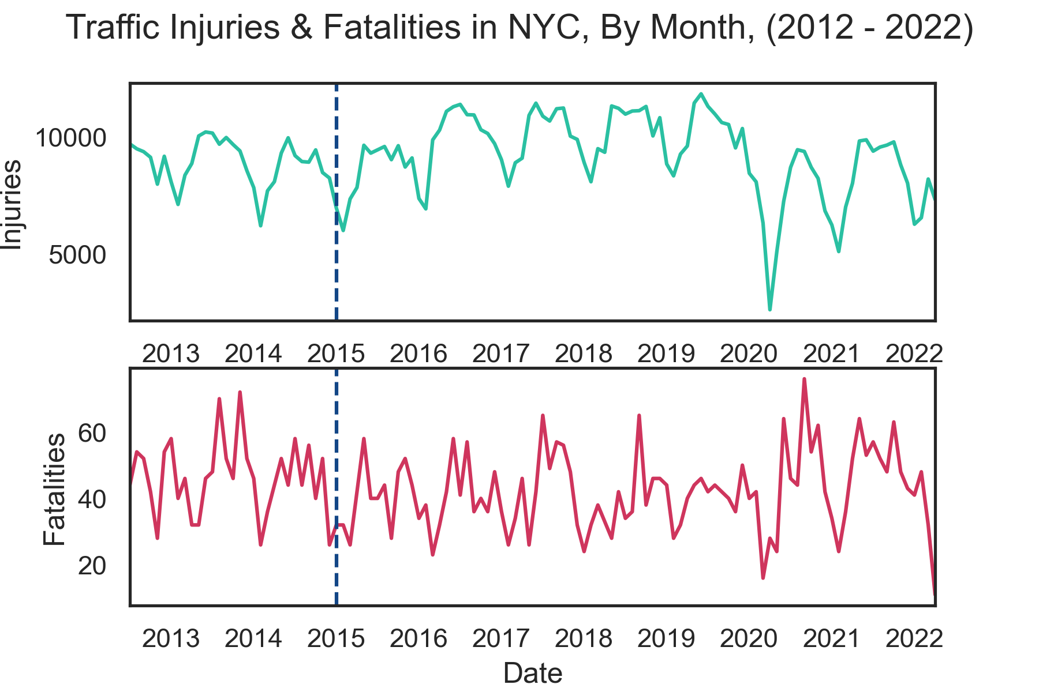

Slide 6
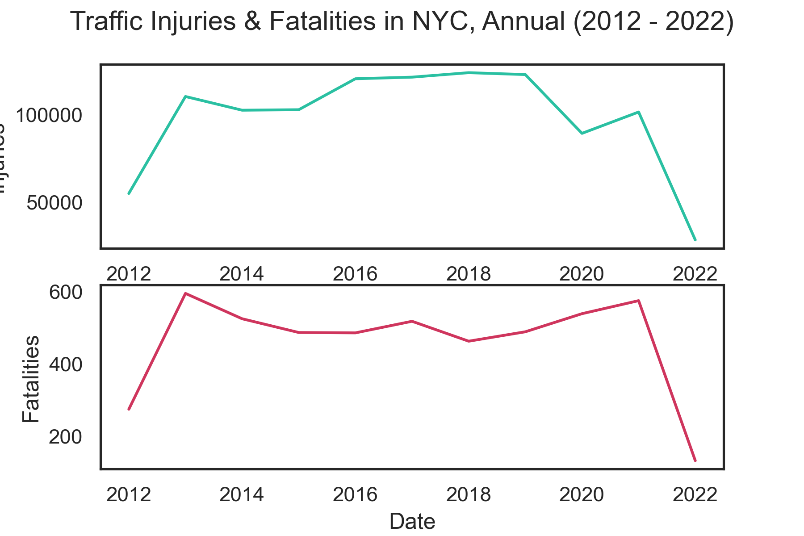

Slide 7
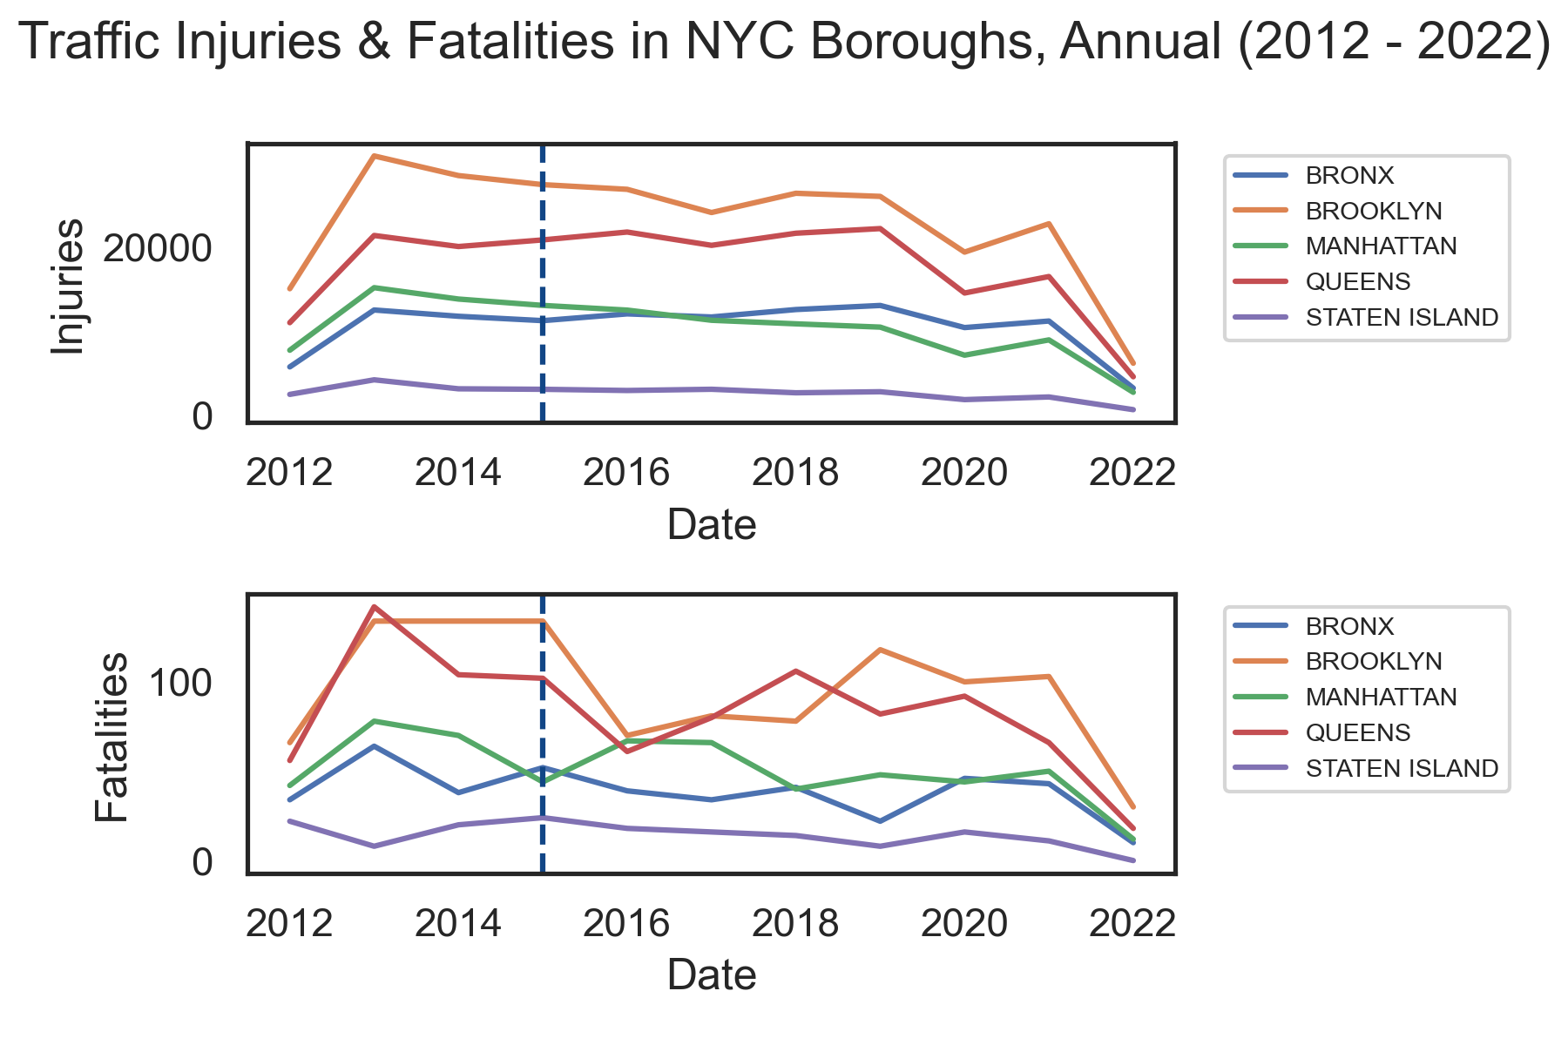

Slide 8
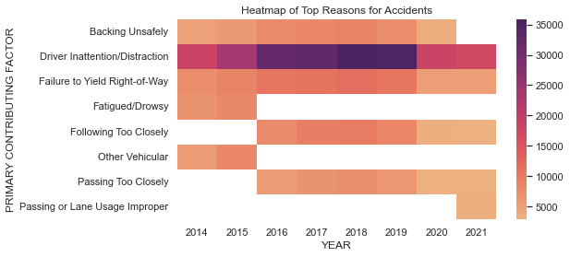
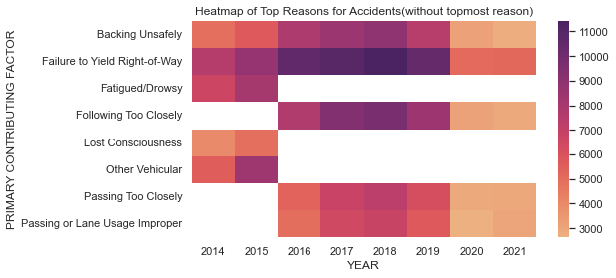

Slide 9
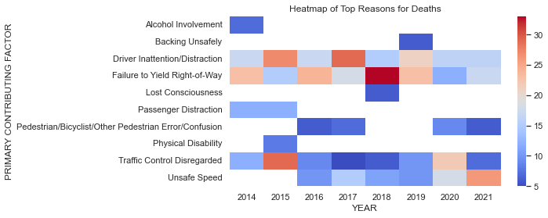

Slide 10
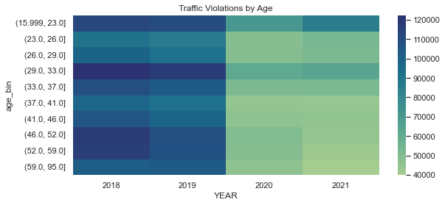

Slide 11
THANK YOU

